Slide 1

ENGG404 – Lecture Chapter 7.6: The Fundamental Process of Management – The Plan-Do-Check-Act Cycle
Fundamentals of RM
RM System and Process
Leadership in RM
Incident Investigation
RM Tools & Challenges
RM in Industry
People & Org.
Applications & Perspectives
On Becoming A Leader In Risk Management

Slide 2
Learning Outcomes of this Module:
Explain and apply the four steps of the fundamental process of management.
Explain how it relates to the risk management process and other risk management principles and practices.
Explain how it is essential for effectively managing residual risk.
Chapter 7.6: The Fundamental Process of Management
2
Notes:
2

Slide 3
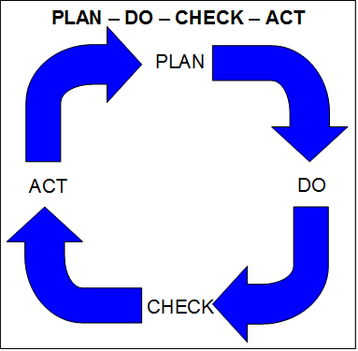
Introduction:
Plan - Do - Check – Act
Originated with Shewart and Deming.
Aimed at quality and productivity in manufacturing
This process and its variants (e.g. Plan-Organize-Lead-Control) are globally practiced.
Tenets: proactive and continuous improvement.
Chapter 7.6: The Fundamental Process of Management
3
Notes:
3

Slide 4
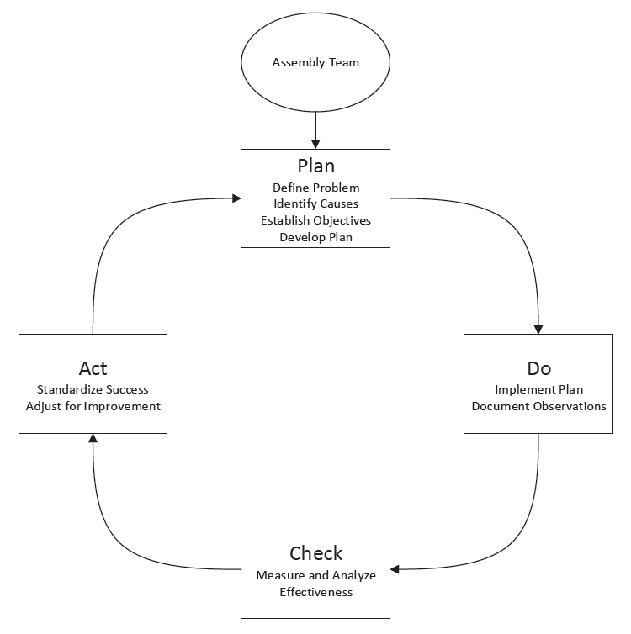
Plan - Do - Check - Act
Assemble Team
4
Notes:
4

Slide 5
Test Implementation at the Individual / Team Level:
Example: Manufacturing of electronic boards
Issues with boards: solder bridge welds, damaged/missing components, wrong components, excessive/insufficient solder
Plan: List the defects, determine which occur most often, target most commonly occurring for assessment and correction, determine % improvement required and time period
Do: Adjust production parameters (temperature, speed, etc) for different product models, track results
Check: Analyze results
Act: Present results to management, standardize changes resulting in significant improvements
Repeat
Chapter 7.6: The Fundamental Process of Management
5
Notes:
5

Slide 6
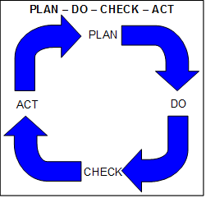
Chapter 3.3 RMS and Chapter 7.6: PDCA
PDCA is driven by management:
Leaders exhibit commitment by planning, doing, and checking, and by acting i.e. by holding their people accountable.
ENGG404 Risk Management System and its 11 Elements:
Management Leadership, Commitment and Accountability.
Risk Assessment and Management of Risks.
Community Awareness and Emergency Preparedness.
Management of Change.
Incident Reporting, Investigation, Analysis and Actions.
Program Evaluation and Continuous Improvement.
Design, Construction and Start-up.
Operations and Maintenance.
Employee Competency and Training.
Contractor Competency and Integration.
Operations and Facilities Information and Documentation.
DRIVER
Chapter 7.6: The Fundamental Process of Management
6
Notes:
6

Slide 7
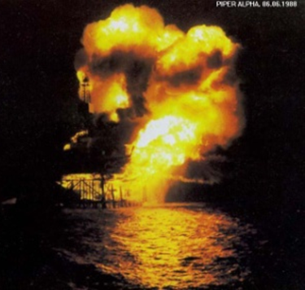
Summary and Key Lesson:
PLAN – DO – CHECK – ACT activities don’t “just happen” – management must make these activities happen.
Managers are actively engaged in driving these activities …
And these four activities are the “essence” of a bias for action!
Piper-Alpha Key Lesson: “Without sound leadership … the control of risks breaks down and unacceptable events will happen.”
Example: Management’s lack of checking the PTW Process lead to deficiencies in controlling risks, and ultimately resulting in the loss incident.
Chapter 7.6: The Fundamental Process of Management
7
Notes:
7

